Slide 1
Notes:
Title Slide:
Energy Saving Schools Challenge

Slide 2
Notes:
What do you know about climate change?
Activity: Climate Change Think, Pair, Share
Ask students what they know about climate change.
Encourage them to think about what they have learnt in other subjects such as Personal, social, health and economic education classes, geography, biology or chemistry. Have they heard about it in the news or at home?
Ask students to discuss in pairs or small groups before sharing with the class (Think, Pair, Share).
Extend Activity: Climate Change Mind Map
Work as a class, in groups or individually to create a mind map of all the different things that they know about climate change.
Organise by focusing on the following three areas:
Causes of climate change (e.g. an increase in human or natural activities that lead to greenhouse gas emissions being added to the atmosphere OR a decrease of natural habitats that take greenhouse gases out of the atmosphere, e.g. forests).
Impacts of climate change (e.g. negative effects of climate change such as fertile land turning into deserts (desertification) or positive impacts such as more crops being grown in previously colder countries).
Solutions to climate change (e.g. technologies that are reducing the amount of carbon emissions being added to the atmosphere such as renewable energy (wind turbines) or electric cars OR behavioural changes such as walking and cycling more instead of driving.
Ask students to share their mind maps as a group or class and add any missing information to their own mind map.

Slide 3
Notes:
Energy Saving Schools Challenge introduction
Read the following challenge introduction:
The climate emergency is one of the most serious challenges that we face.
Your challenge, over the next five lessons, is to discover different ways that we can address the climate emergency.
By the end of the lessons you will have created an Energy Saving Action Plan which will include a list of different things that you can do at home and in school to help reduce your greenhouse gas emissions.
Share the following climate emergency definition: https://www.oxfordlearnersdictionaries.com/definition/english/climate-emergency?q=climate+emergency
Activity: What is the climate emergency?
Ask students to write their own definitions of the climate emergency. If possible, encourage them to look up the word’s climate and emergency in the dictionary (see definitions below).
Climate (definition)-: the regular pattern of weather conditions of a place
Emergency (definition): a sudden serious and dangerous event or situation that needs immediate action to deal with it
Share each response/student answer as a class then read the official definition by clicking on the link in the lesson slide or see below:
Climate Emergency (definition): a situation in which immediate action is needed to reduce or stop climate change and prevent serious and permanent damage to the environment
Show the Energy Saving Action Plan to students and explain that they will be filling this out during the last lesson.

Slide 4
Notes:
Title Slide:
Climate Change and Energy Use

Slide 5
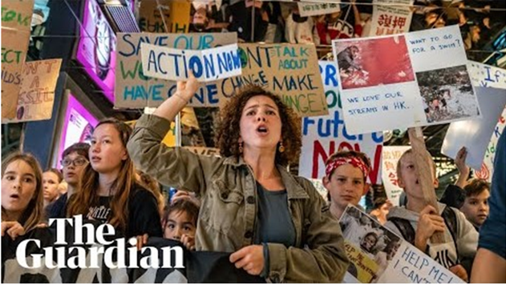
Video link
Notes:
Why are students marching?
Activity: Climate Marches Video - https://www.youtube.com/watch?v=oJ_QkjieLmw
Play the video (2 minutes) and then as students to answer the following two questions:
Why are students marching?
Students are marching to raise awareness of the climate emergency and encourage governments, businesses and people in general to take action to stop it.
Why do you think the film makers made this video?
To highlight that this is a global issue and that school children all over the world want change.
Ask students to share their answer as a pair, group or class.
__________
Extend Activity: Additional Questions
Discuss the following two questions:
How does this video make you feel?
What does it make you want to do?
Ask students to share their answer as a pair, group or class.

Slide 6
Notes:
Where does our energy come from?
Read the following:
Humans use a lot of energy.
For example, we use it when we walk, to charge our phones, to light up our rooms, to fly to other countries and to power our cars. But all energy must come from somewhere.
Activity: Where does our energy come from?
This activity will help students understand that everything we do and most of the things that we use require energy.
Ask a student to walk across the room to the door and back to their seat.
As a class discuss, where did they get the energy to do that?
Walking = Food
Now ask another student to turn the lights off and on. Again, discuss, where do the lights get their energy from?
Lights = Electricity
Ask student to complete the two remaining examples on their own:
Driving = Petrol
Heating your home = electricity or gas
__________
Extend Activity: Make the link with greenhouse gases
Explain that each of these energy sources is also usually a source of greenhouse gas emissions.
For each of the four examples above, ask students to write a sentence explain how greenhouse gases might be emitted by using that energy source, see examples below:
Running – food and drink – greenhouse gases are released when food is transported from where it is grown to the supermarkets.
Lighting – electricity, some of which comes from coal and natural gas power stations – these emit greenhouse gases
Driving – petrol – driving causes carbon dioxide to be emitted into the atmosphere
Heating your home – electricity or gas – releases greenhouse gas emissions

Slide 7
Notes:
How is energy linked to climate change?
Activity: Fill in the blanks
Ask students to fill in the blanks to discover what climate change is and how we are causing it. See answer below:
Most of our current sources of energy release GREENHOUSE GASES such as CARBON DIOXIDE into the atmosphere.
These gases trap the suns HEAT causing the TEMPERATURE to rise.
This means that a lot of human activities cause CLIMATE CHANGE.

Slide 8
Notes:
What are the main sources of carbon dioxide (CO₂) emissions in our lives?
Activity: Guess the CO2 source:
Using the images as clues, ask students to work in pairs to list the six different sources of carbon dioxide.
Answers by order in row:
Transport, Diet Food, Heating
Aviation, Electricity, Waste
Activity: Rank the sources from largest to smallest
Now get students to rank these activities from what they think will have the highest to lowest CO₂ emissions in the average UK household.
(answers on next slide)

Slide 9
Notes:
UK Average Household CO₂ emissions in kg
Ask students to share their results. Are they surprised by the order of the list?
Extend Activity:
Based on the equation below, ask students to calculate how many balloons of carbon dioxide are released by the average household’s activities every year.
1kg of carbon dioxide = 33 balloons full of CO₂
Source of calculation.
#1 Heating = 90,585 balloons of CO₂
#2 Transport = 78,111 balloons of CO₂
#3 Diet / Agriculture = 52,503 balloons of CO₂
#4 Aviation = 33,891 balloons of CO₂
#5 Electricity = 24,915 balloons of CO₂
#6 Waste = 10,065 balloons of CO₂
Total balloons of carbon dioxide released each year per average UK households:
290,070 balloons of carbon dioxide per year.

Slide 10
Notes:
What can we do?
Ask a student to read out the information on the slide.
Underline the following key words and phrases on the slide. Ask students to copy down the following important definitions.
Greenhouse gases
Gases such as carbon dioxide which trap the sun’s heat in our atmosphere. If more greenhouse gases are added to the atmosphere the temperature will rise leading to climate change.
Climate change:
Large scale and long-term changes to weather (temperature and precipitation)
Net Zero:
When the amount of greenhouse gas emissions produced equals the amount of emissions taken out of the atmosphere*
*natural habitats such as forests or machines can take greenhouse gases out of the atmosphere.

Slide 11
Notes:
In the next three lessons:
Explain that over the next three lessons students will be learning about:
Renewable energy
Low carbon transport
Home energy efficiency

Slide 12
Notes:
Title Slide: The Renewables Revolution

Slide 13
Notes:
Activity: Renewable energy, leading the world.
Activity: Quote Discussion
Ask a student to read out the quote.
“The nation that leads in renewable energy, is the nation that will lead the world.”
Students should discuss the following questions in pairs before feeding back as a class:
What do we you know about renewable energy?
Renewables (definition): types of energy that can be replaced naturally such as energy produced from wind or water
Why do you think the nation/country will lead the world in 10 – 20 years?
Electricity is one of the most important assets that we have.
Renewable energy is becoming more and more valuable as countries are looking to increase the amount of electricity they get from renewable energy.
The country that leads the world in renewable energy technology will have a lot of power to influence other countries.

Slide 14
Notes:
What uses electricity during your daily routine
Activity: Electricity List
This activity aims to get students to start thinking about their daily routine, from the moment they wake up to the moment they go to sleep.
Give students two minutes to create a list of all the things that they use during their day which use electricity? (see examples below)
Mobile phone
Electric shower
Hair drier
Electric toothbrush
Home lighting
Heating (if electric)
Fridge
Toaster
Kettle
Microwave
Radio
Electric Bus, Underground, Tram, Train
School doors
School lighting
Classroom projector
Computer
Calculator
Television
Games console
Oven
Dish washer
Washing machine / tumble drier

Slide 15
Notes:
Where does electricity come from?
Activity 1: Electric Journey
Ask the students to close their eyes and listen as you (or a chosen student) reads the following script:
Where does electricity come from?
I want you to image we can all shrink ourselves down and follow the path that the electricity takes to get to our lightbulb.
First, we must travel along all the wires in our school, weaving down through walls and along corridors, passed the school hall and head teachers’ office before leaving the school building.
Next, we join larger wires and cables that run beneath the roads outside our school and through the air, held up by electricity poles. We have now joined the national grid of electricity.
As we travel along, lots of other buildings and homes are attached to these larger cables. I want you to image that we pass the junction where your home is connected. This is how you get electricity at home.
Next, we would have to go a fenced in area called a substation, which is full of large coils and machinery, a place where electricity is collected and then distributed out to homes, businesses and this school.
From here the cable we’re in shoots into the sky; you get an amazing view of the countryside as we flow hundreds of miles, held up between huge pylons, many times higher than our school.
We’re now near the source of where electricity comes from.
At this point there are several places where we could end up.
If you can, I want you to imagine one of those places and then open your eyes.
END OF SCRIPT
Activity 2: Electricity sources
Now ask students the following question:
Where you think this electricity comes from?
(Ask for as many answers as students can think of.)
(Click on the link below to be taken to a Wikipedia page about each source of energy.)
Answers:
Coal power station
Natural gas power station
Nuclear power plant
Wind farm / wind turbine
Solar panels
Hydroelectric power station
Extend Answers:
Tidal energy
Wave energy
Geothermal energy
Activity 3: Identify renewable sources
Read the following definition of renewable energy:
‘Renewable energy comes from natural sources that never run out.’
Ask students to identify from their list (see above) which energy sources are renewable:
Answers:
Wind farm / wind turbine
Solar panels
Hydroelectric power station
Extend Answers:
Tidal energy
Wave energy
Geothermal energy

Slide 16
Notes:
Where does electricity come from? (part 2)
Explain that in the United Kingdom we get most of our electricity from four sources but need to move towards renewable energy if we are going to meet net zero by 2050.
Coal – 5.1%
Natural gas – 39.5%
Nuclear – 19.5%
Renewable energy – 33%

Slide 17
Notes:
What do we need to do to increase the amount of electricity produced from renewable sources?
Activity: A renewable future
In pairs, ask students to discuss the following question:
What do we need to do to increase the amount of electricity produced from renewable sources?
Answers will likely focus on the following:
Telling people about renewable energy and why it’s important
Encouraging people to switch to renewable energy providers
Petition the government to create laws and legislation to force companies to move towards renewable energy
Spend money (invest) in renewable energy
Build more wind turbines, solar panels, hydro-electric power stations etc.

Slide 18
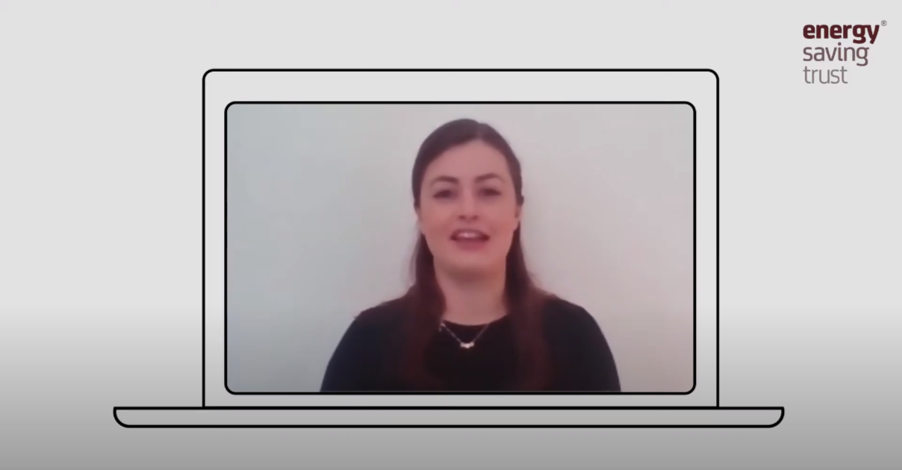
Video link
Notes:
The Renewables Revolution – Expert Video - https://www.youtube.com/watch?v=NnFJvZSsxhA&feature=youtu.be
Students watch the video and make notes in order to answer the following questions.
What is renewable energy and why does it matter?
Renewable energy comes from natural sources that never run out such as wind energy, hydro-electric energy or solar power.
Extend Question:
What is one new thing you learnt from the video?
What is the most interesting thing you learnt from the video and why?

Slide 19
Notes:
8
What can you do to help?
During this activity students will discuss and share all the different things they could do to promote renewable energy.
Activity: Renewable Energy Mind Map
Ask students to draw a renewable energy source such as a solar panel or wind turbine – this is the centre of their mind map.
Now ask students to spend five minutes annotating all the things they think they could do to encourage others to swap to renewable energy.
Share suggestions as a class and ask the class to add any missing suggestions to their own diagram.
Example student actions from video:
Write a letter to the head teach and ask if the school can switch to using renewable energy.
Make a poster about all the reasons why you should switch to a renewable energy supplier and put it up at home.
Have a chat with whoever pays the bills in the house. If they say no, tell them about all the reasons why it’s important for us all to switch to renewable energy. They might even save some money.
Find out more information about renewable energy on BBC Bitesize.
Encourage students to create their own ideas.

Slide 20
Notes:
Title Slide: Low Carbon Travel

Slide 21
Notes:
Low Carbon Travel Definition
Share the following important definition with students.
Low Carbon Travel: Transport that when used emits no or very few carbon emissions into the atmosphere.

Slide 22
Notes:
To the moon and back
Ask a student to read out the fact.
In 2018, 328 billion miles were driven on Great Britain’s roads. That’s the same as driving to the moon and back, 686,000 times.
How do we travel?
Activity: Travel Personas
Ask a student to read out each of the transport personas and their most recent social media posts. Then ask student to answer the following questions:
How many forms of travel are mentioned?
See answer to question 2.
Rank the different types of travel from most to least C02 emissions
Transport from most to least CO2 emotions:
flying,
driving
taking the bus
electric taxi
electric bike
peddle bike
walking
Who is a traveling low emissions hero? Why?
@Itmatters – very low transport carbon emissions due to walking or taking public transport
Who is a traveling low emission zero? Why?
@JustTravels – very high transport carbon emissions due to a lot of flying.

Slide 23
Notes:
How do we travel?
Activity: Travel Personas
Ask a student to read out each of the transport personas and their most recent social media posts. Then ask student to answer the following questions:
How many forms of travel are mentioned?
See answer to question 2.
Rank the different types of travel from most to least C02 emissions
Transport from most to least CO2 emotions:
flying,
driving
taking the bus
electric taxi
electric bike
peddle bike
walking
Who is a traveling low emissions hero? Why?
@Itmatters – very low transport carbon emissions due to walking or taking public transport
Who is a traveling low emission zero? Why?
@JustTravels – very high transport carbon emissions due to a lot of flying.

Slide 24
Notes:
Transport Hierarchy.
Activity: How often do you use these forms of transport?
Ask students to draw the diagram leaving room on the right of their pyramid for task 2.
Task 1: Diagram Discussion
As pairs discuss what they think the diagram shows.
Different forms of transport have different C02 emissions. We can easily show this by using something called a transport hierarchy.
The forms of transport at the top of the diagram have the lowest carbon emissions whilst the transport at the bottom have the highest.
Where possible people should always try to use forms of transport at the top of the hierarchy and reduce the transport at the bottom.
Share with students the following definitions:
Ultra-low emission vehicle: a vehicle that emits a very small amount of greenhouse gases into the atmosphere.
Task 2: Transport Tally
Ask students to think about their past week, how many forms of transport did they use outside their home? Ask them to add a sub heading above the right side of their pyramid:
‘My weekly transport’
Now they should think about the previous week and tally up, beside each level of the pyramid, what forms of transport they have taken. For example:
Active travel: IIIII IIIII IIIII = 20
Public transport: IIIII IIIII = 15
Electric car: 0
Petrol car: IIIII IIIII III = 18
Now ask students to think if they could have swapped any of their journeys in the past week for a form of transport higher up the hierarchy.
For example, were there any short car journeys that they took that they could have swapped for walking?
Share some examples with each student.

Slide 25
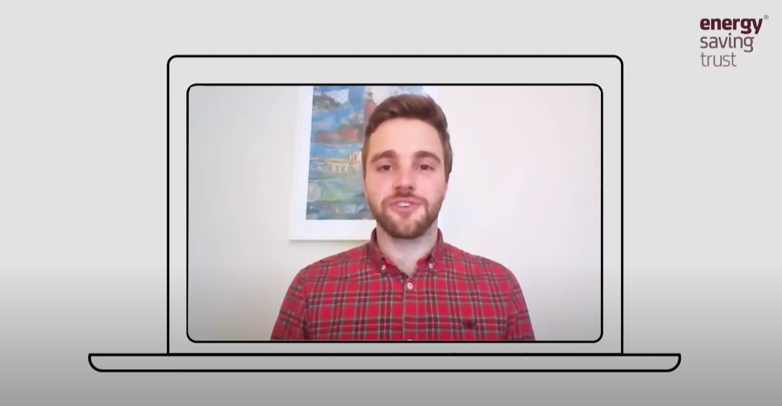
Video link
Notes:
Low Carbon Travel– Expert Video
Students watch the video and make notes in order to answer the following question.
1. What is low carbon transport and why does it matter?
Low carbon transport is a form of transport that when used emits little or no carbon emissions into the atmosphere per person. This means that fewer greenhouse gases are being added to the atmosphere and therefore these forms of transport have a lower impact on climate change.
Extend Question:
2. What is one new thing you learnt from the video?
3. What is the most interesting thing you learnt from the video and why?

Slide 26
Notes:
What can you do to help?
During this activity students will discuss and share all the different things they could to promote renewable energy.
Activity: Low Carbon Transport Mind Map
Ask students to draw a form of low carbon transport such as a person walking, cycling or riding the bus.
Now ask students to spend five minutes annotating all the things they think they could do in their lives to use low carbon transport options more frequently and encourage others to do the same.
Share suggestions as a class and ask the class to add any missing suggestions to their own diagram.
Example student actions from video:
Use active travel (walking, cycling or ‘wheeling’) to get to school if possible.
Put a note/create a poster and put at home to encourage other people to use low carbon and active travel options more regularly.
Other examples:
Organise an active travel at school week to encourage as many people to get out and exercise whilst traveling to school.
Instead of traveling long distances to go on holiday, why not explore your local area instead.
Encourage students to create their own ideas.

Slide 27
Notes:
Title Slide: energy saving at home

Slide 28
Notes:
Energy Efficient:
Read the description of energy efficiency.
‘A device or building that is energy-efficient uses relatively little energy to provide the power it needs.’
Energy efficient homes and products use a lot less energy that those that are not efficient, therefore contributing less to the climate emergency.

Slide 29
Notes:
Why is it important to save energy at home?
Activity: Why is it important to save energy at home?
Ask students to work in pairs/groups to come up with two reasons why they think it is important to save energy at home. Example answers below:
Reduce the cost of their energy bill
Unless from nuclear or renewable energy, electricity sources are a large cause of greenhouse gas emissions
Heating is the number one contributor to carbon emissions in our lives
Students will then share their ideas as a class.
Activity:
Ask students to vote on which reason they think is most important and discuss why.

Slide 30
Notes:
How can you save energy at home?
Activity: Solving Energy Wasters
In our homes, we need energy for heating, cooking, lighting and to power all our appliances and gadgets.
However, there are lots of ways that we waste energy at home.
The students’ task is to write down ways to solve three of the following ‘home energy wasters’ each. Encourage them to be creative and share their ideas as a class.
Energy Wasters – Energy Savers:
Heating turned up too high – develop an app which monitors when people have left the house and program it to turn the heating off when it is not needed.
Heat lost out of windows and through roofs – put a note on each window reminding people to only open it when the heating is turned off.
Devices left plugged in and on standby – every time someone leaves a device on standby, they must put some money in an energy wasters jar to be used for family takeaway movie night.
People taking long showers – put a timer in the shower that people can turn on when they get in, reminding them to keep their showers under a certain length of time.
Lights left on – have an automatic sensor that senses when people leave a room and turns the lights off.

Slide 31
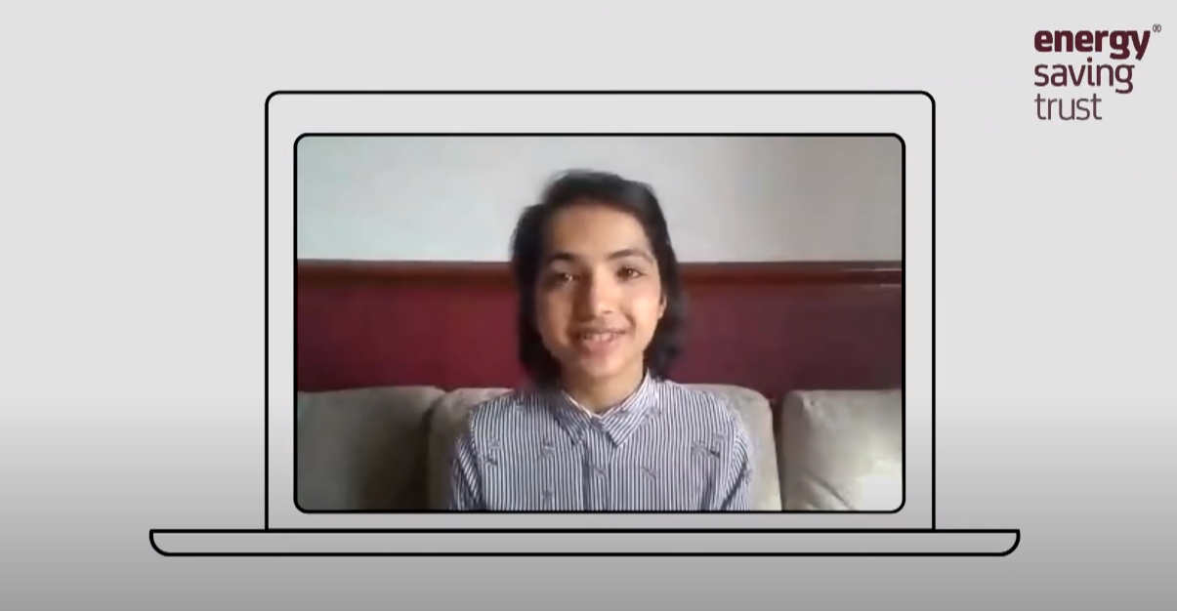
Video link
Notes:
Energy Saving at Home– Expert Video: https://www.youtube.com/watch?v=2TWTLav2WYI&feature=youtu.be
Students watch the video and make notes in order to answer the following question.
1. What is an example of a home energy efficiency solution.
Insulating your walls and roof is a great way to stop extra heat from escaping your building.
Extend Question:
2. What is one new thing you learnt from the video?
3. What is the most interesting thing you learnt from the video and why?

Slide 32
Notes:
What can you do to help?
During this activity students will discuss and share all the different things they could to promote energy saving habits at home.
Activity: Energy Efficiency Mind Map
Ask students to draw a house.
Now ask students to spend five minutes annotating all the things they think they could do in their lives to save energy at home and encourage others to do the same.
Share suggestions as a class and ask the class to add any missing suggestions to their own diagram.
Example student actions from video:
When buying new electronics, always try to buy electronics which use less energy. For example, buy a laptop instead of a desktop computer.
Turn off devices at school and home.
Spend 1 minute less in the shower.
Only boil water that you need when making a cuppa.
Encourage students to create their own ideas.

Slide 33
Notes:
Title Slide: Energy Saving Action Plan

Slide 34
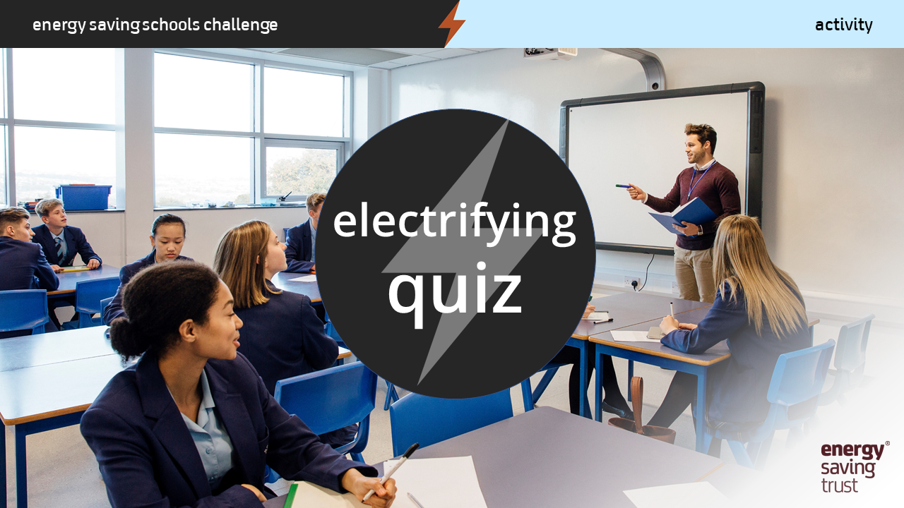
Notes:
Electrifying Quiz
Use the following nine question quiz to test students’ understanding and knowledge retention:
What is the main source of CO2 emissions from the average UK household? Heating
What is the main greenhouse gas that causes climate change? Carbon Dioxide
When does the UK government want to reach Net Zero carbon emissions? 2050
What are the four main sources of electricity in the UK? Coal, Natural Gas, Nuclear, Renewable Energy
Name three different types of renewable energy: wind, solar, hydro-electric, geothermal, tide, wave.
How many miles were driven on British roads in 2018?
a) 3 billion
b) 32 billion
c) 328 billion (correct answer)
When traveling what has the highest carbon dioxide emissions? Flying
When traveling, what has the lowest carbon dioxide emissions? Walking or Cycling
Give one example of how you can save energy at home. (various options including, turning heating down by 1 degree, turning off all electronic devices left on standby, turning off lights when leaving room).

Slide 35
Notes:
Energy saving action plan
Activity: Complete action plans
Using the three mind maps that were created during the previous three lessons, students should now be each given an energy saving action plan worksheet that they can fill in with things they can do in their daily lives to reduce their energy consumption and help address the climate emergency.
Ideas for saving energy at school
Make a poster to encourage others to take one of your energy saving actions.
Invite a local councillor or MP into school to talk about what the local council or government are doing to encourage people to save energy.
Organise a school assembly to tell the rest of the school about energy saving and the climate emergency.
Activity: Create a poster
Each action plan requires students to create a poster, promoting one of the three lesson topics:
Renewable energy
Low carbon transport
Saving energy at home
Students can then put their posters up at home or in class, to encourage others to think about how they use energy and where it comes from.

Slide 36
Notes:
Final thought: No one is too small to make a difference.
Read the quote and remind students that like Greta Thunberg, every single one of them has the power to make a difference.
Thank you for completing the energy saving schools challenge.

